Slide 1
Suravarapu Deepthi
Final Project
3/21/2024 Annual Review

Slide 2
Keyloggers and Security
3/21/2024 Annual Review

Slide 3


AGENDA
Introduction
Problem Statement
Project Overview
End Users
Solution and Value Proposition
Unique Selling Point (Wow Factor)
Modelling
Results
Conclusion
3/21/2024 Annual Review

Slide 4

PROBLEM STATEMENT
Keyloggers pose a significant threat to cybersecurity by silently capturing keystrokes, compromising sensitive information such as passwords and financial data.
3/21/2024 Annual Review

Slide 5

PROJECT OVERVIEW
This project aims to develop a robust solution to detect and prevent keylogger attacks, enhancing overall cybersecurity measures.
3/21/2024 Annual Review

Slide 6

WHO ARE THE END USERS?
End Users:
Individuals
Businesses (small, medium, large)
Government agencies
Educational institutions
3/21/2024 Annual Review

Slide 7

YOUR SOLUTION AND ITS VALUE PROPOSITION
Our solution employs advanced detection algorithms to identify keylogger activities in real-time, providing proactive defence against data theft.
3/21/2024 Annual Review

Slide 8

THE WOW IN YOUR SOLUTION
Unique Selling Point (Wow Factor):
Real-time anomaly detection with minimal impact on system performance.
Comprehensive reporting and analysis of detected threats.
Integration with existing cybersecurity frameworks.
3/21/2024 Annual Review
8

Slide 9
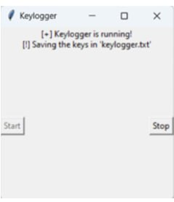
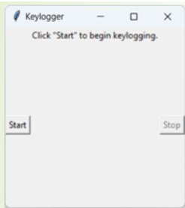
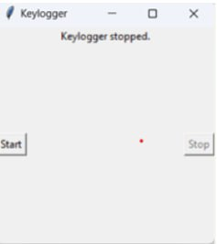

MODELLING
Teams cam add wireframes
3/21/2024 Annual Review
9

Slide 10
RESULTS
3/21/2024 Annual Review
10

Slide 11
GitHub Links
git@github.com:suravarapudeepthi09/APSSDC_Final-Project.git

